Slide 1
UbiCom Book Slides
Chapter 3
Smart Devices and Services
Stefan Poslad
http://www.eecs.qmul.ac.uk/people/stefan/ubicom
Ubiquitous computing: smart devices, environments and interaction

Slide 2
Related Links
Basic Distributed Computer Interaction Models in this chapter are the basis for more advanced systems in later chapters, e.g., EDA Architecture can be used for:
  Sense & Control systems (Chapter 6)
  Context-based Systems (Chapter 7)
  Reflexive Intelligent Systems (Chapter 8)
Mobile Distributed Systems (Chapter 4)
Management of Distributed Systems (Chapter 12)
Advances in Distributed Systems (Chapter 13)
Ubiquitous computing: smart devices, environments and interaction

Slide 3
Chapter 3 Slides
The slides for this chapter are also expanded and split into several parts in the full pack
Part A: System Architectures
Part B: Middleware, SOC & P2P
Part C: Service Provision Life-cycle & Service Discovery
Part D: Service Invocation
Part E: Volatile Service Invocation & Service Composition
Part F: MTOS, BIOS & VM 
Ubiquitous computing: smart devices, environments and interaction

Slide 4
Overview
Smart Device and Service Characteristics √
Distributed System Viewpoints
System Abstraction
Partitioning and Distribution of System Components
Proxies and Middleware
Service Oriented Computing (SOC) & Grid Computing
Peer-to-Peer Systems (P2P)
Service Provision Lifecycle 
Service Discovery
Service Invocation
Service Composition
MTOS, BIOS & VM
Ubiquitous computing: smart devices, environments and interaction

Slide 5
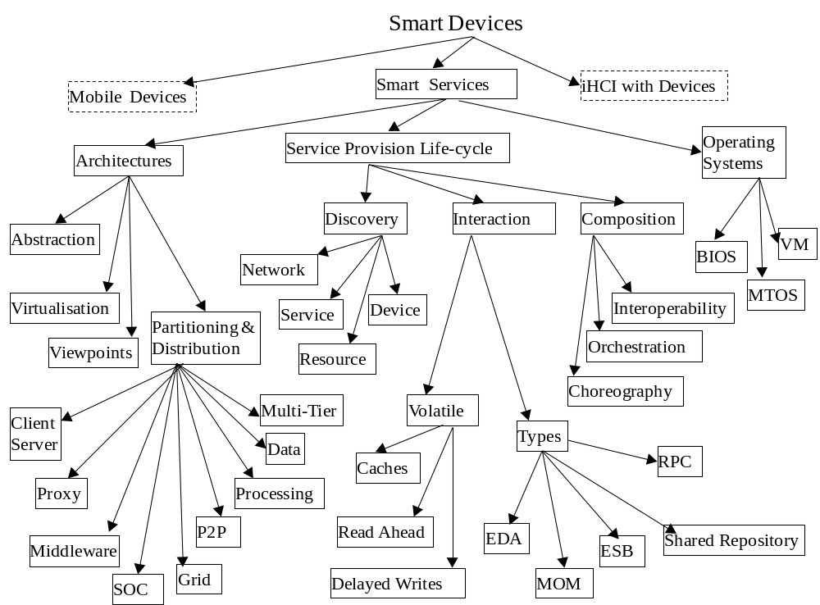
Ubiquitous computing: smart devices, environments and interaction

Slide 6
Smart Device Characteristics
Multi-purpose ICT devices, operating as a single portal to multiple remote vs. local application services
Usually personalised devices, specified owner.
Locus of control and user interface resides in the smart device.
Main characteristics of smart devices: mobility, open service discovery, intermittent resource access.
Important type of smart device is smart mobile device
Here, we focus on design issues for the service model used by UbiCom Applications
Ubiquitous computing: smart devices, environments and interaction

Slide 7
Overview
Smart Device and Service Characteristics
Distributed System Viewpoints √
System Abstraction
Partitioning and Distribution of System Components
Proxies and Middleware
Service Oriented Computing (SOC) & Grid Computing
Peer-to-Peer Systems (P2P)
Service Provision Lifecycle 
Service Discovery
Service Invocation
Service Composition
MTOS, BIOS & VM
Ubiquitous computing: smart devices, environments and interaction

Slide 8
Distributed System Viewpoints
Distributed ICT Systems can be modelled from multiple complementary viewpoints with respect to:
Viewpoints can be regarded as architectural patterns, conceptual models that capture the essential elements of an ICT system architecture and its interrelationships. Multiple viewpoints:
  Individual user view
  Enterprise user view:
  Information system, service or computation platform view:
  Network view: network elements and computer nodes
Viewpoint model standards: RM-ODP (ISO), IEEE 1471 model
Ubiquitous computing: smart devices, environments and interaction

Slide 9
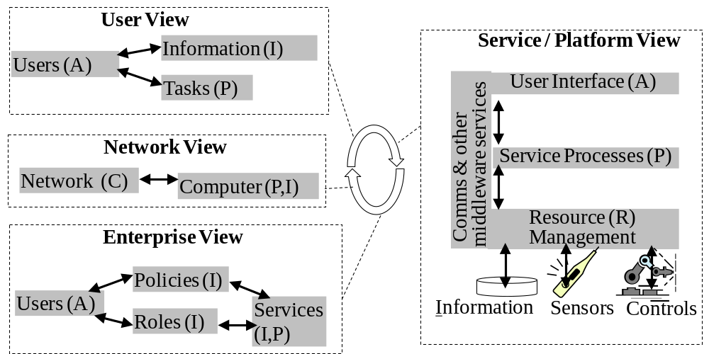
Distributed System Viewpoints
A = Access/presentation, I = Info./data, P = Processing/computation, C=Comms/networking
Ubiquitous computing: smart devices, environments and interaction

Slide 10
Overview
Smart Device and Service Characteristics
Distributed System Viewpoints
System Abstraction √
Partitioning and Distribution of System Components
Proxies & Middleware
Service Oriented Computing (SOC) & Grid Computing
Peer-to-Peer Systems
Service Provision Lifecycle 
Service Discovery
Service Invocation
Service Composition
MTOS, BIOS & VM
Ubiquitous computing: smart devices, environments and interaction

Slide 11
Reducing System Complexity using Abstraction (Modularisation)
System architectures focus on the idea of reducing complexity through both a separation of concerns using modularisation & transparency
Two common criteria for modules:
  high cohesion
  loose-coupling
Meyer (1998) uses five criteria for modularisation:
  Decomposability:
  Composability:
  Understandability:
  Continuity:
  Protection:.
Ubiquitous computing: smart devices, environments and interaction

Slide 12
Reducing System Complexity using Abstraction (interoperability)
Abstractions define those things that are important in a system
Abstraction that simplifies the view or access to internal functionality to the outside, is also called an interface.
Ubiquitous computing: smart devices, environments and interaction

Slide 13
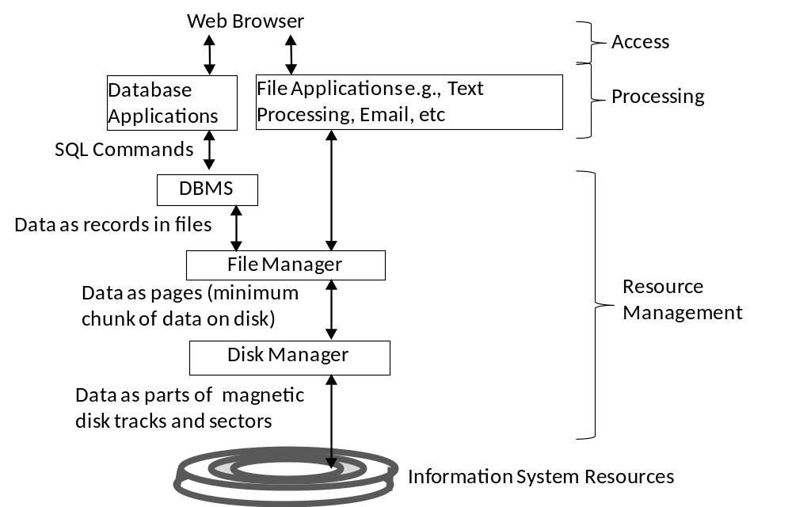
System View: Example of Abstraction
Ubiquitous computing: smart devices, environments and interaction

Slide 14
Reducing System Complexity using Abstraction (Transparency)
Abstractions make transparent properties not needed by interactions
Important types of transparency for distributed services include:
  Access transparency:
  Concurrency transparency
  Failure transparency (Fault Tolerance)
  Migration transparency
  Scaling transparency
In practice, ideal transparency of a single image for all resources, all the time, under all conditions is hard to achieve
  Usually only when the distributed system is operating normally.
Ubiquitous computing: smart devices, environments and interaction

Slide 15
Reducing System Complexity using Abstraction (virtualisation)
Abstractions alone do not necessarily support interoperability
  Explain here
Virtualisation provides a way to solve this limitation of abstraction:
  See later
Ubiquitous computing: smart devices, environments and interaction

Slide 16
Overview
Smart Device and Service Characteristics
Distributed System Viewpoints
System Abstraction
Partitioning and Distribution of System Components √
Proxies and Middleware
Service Oriented Computing (SOC) & Grid Computing
Peer-to-Peer Systems (P2P)
Service Provision Lifecycle 
Service Discovery
Service Invocation
Service Composition
MTOS, BIOS & VM
Ubiquitous computing: smart devices, environments and interaction

Slide 17
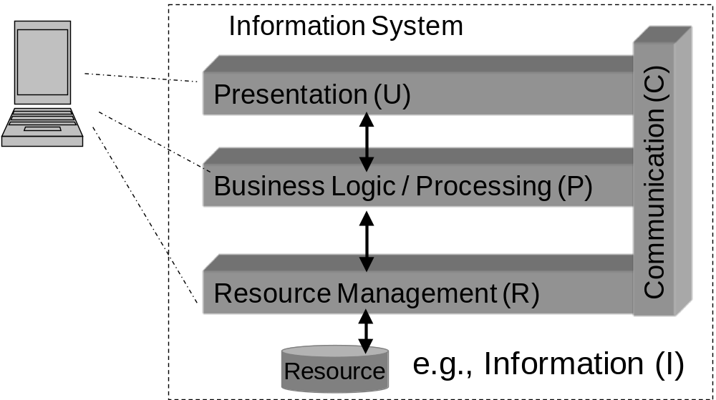
Partitioning & Distribution of System Components: None
Copy of data or applications downloaded onto device, then it is used off-line
Ubiquitous computing: smart devices, environments and interaction

Slide 18
Partitioning & Distribution of System Components: None
Advantages?
Disadvantages?
Ubiquitous computing: smart devices, environments and interaction

Slide 19
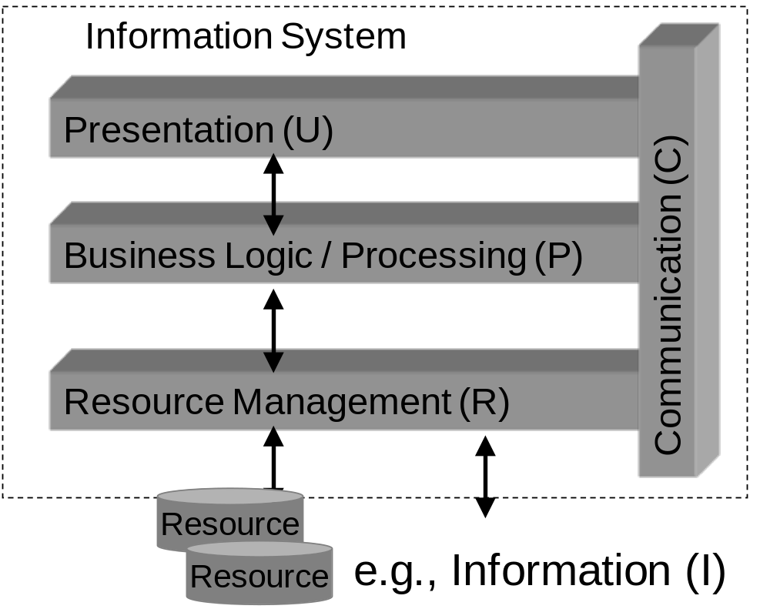
Partitioning & Distribution of System Components
Ex: how can we distribute these components?
Ubiquitous computing: smart devices, environments and interaction

Slide 20
Partitioning & Distributing System Components
Range of designs for partitioning and distributing services:
Consider type of access device, resources, communication: several ways to distribute these, e.g.,
High resource access devices can act self-sufficiently,
Low / poor resource access devices
Ubiquitous computing: smart devices, environments and interaction

Slide 21
System Architectures: Partitioning Example
Discuss How to partition a 2 player Person versus Machine Chess Application in terms of a client-server design / for use on a mobile device
Network Usage
Low
High
CPU Usage
Low
High
Data Memory Usage
Low
High
Ubiquitous computing: smart devices, environments and interaction

Slide 22
Architectures: Client Server model
Asymmetric distributed computing model with respect to where resources reside and the direction of the interaction.
Client-server interaction is also asymmetric:
Asymmetry benefits?
Ubiquitous computing: smart devices, environments and interaction

Slide 23
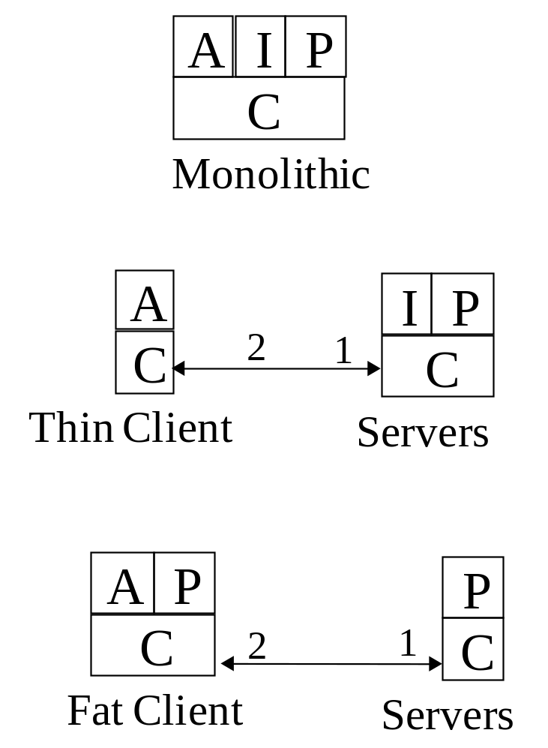
Partitioning and Distribution: Client-Server Model
Ubiquitous computing: smart devices, environments and interaction

Slide 24
Client Server Model
System configuration (partitioning and distribution) depends upon:
  network links;
  local resources,
  remote service availability;
  type of application,
  service maintenance model.
Different degrees of resources on access devices (clients)
Resource poor (thin-client server model):
  reliance on external servers, network supports remote service access on demand
Ubiquitous computing: smart devices, environments and interaction

Slide 25
Client Server Model
Processing needed to adapt content to different types of terminals
Thin-client server model is often considered to be easier to maintain
Thin-clients offer very limited application platform
Ubiquitous computing: smart devices, environments and interaction

Slide 26
Client Server Model
How to cope with unreliable and low-performance networks using client-server model?
Argues for a degree of self-reliance & use of local processing and data resources
Fat client model is suitable when?
Type of processing in access device depends on type of application.
  E.g.,
  E.g.,
Ubiquitous computing: smart devices, environments and interaction

Slide 27
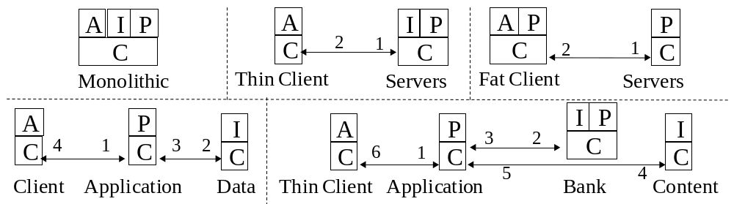
Partitioning & Distributing System Components: Summary of Models
Ubiquitous computing: smart devices, environments and interaction

Slide 28
Partitioning & Distributing System Components: Summary of Models
Different designs for Information-based UbiCom systems:
  based upon how their A, P and I components are distributed.
Functions can be distributed over multiple different computer nodes or tiers:
  1-tier, monolithic system, appliance model:
  2-tier, thin-client server:
  2-tier, fat-client server model:
  Multi-tier (3,4 ... N-Tier) systems:
Ubiquitous computing: smart devices, environments and interaction

Slide 29
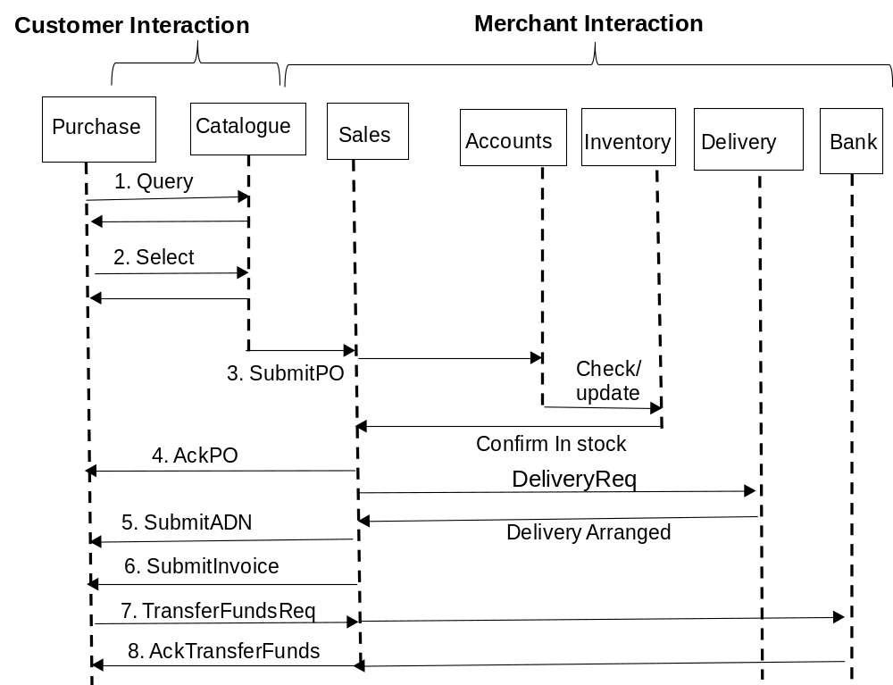
Ubiquitous computing: smart devices, environments and interaction

Slide 30
Partitioning and Distributed Data (D) Storage
I, P, A and D can themselves be partitioned & distributed
Examples of Partitioned & Distributed D
  Transaction Monitors (TM): distributed data transactions;
  Data Warehouses, centralised analysis of distributed data
  Distributed Databases: distributed queries
Ubiquitous computing: smart devices, environments and interaction

Slide 31
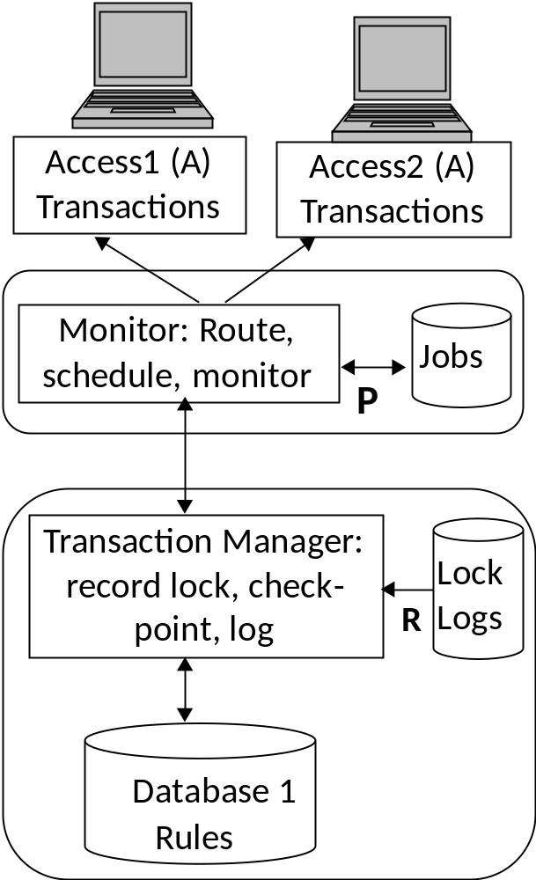
Distributed Data (D) Storage: Transaction Processing
Ubiquitous computing: smart devices, environments and interaction

Slide 32
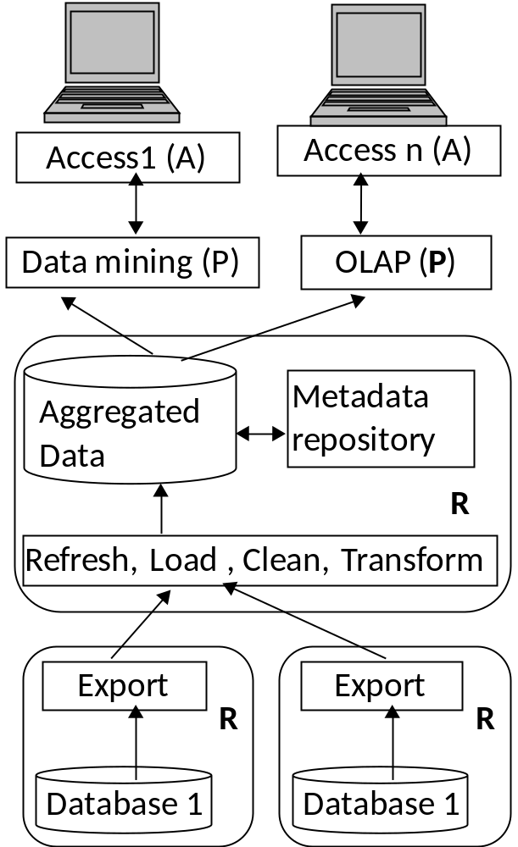
Distributed Data (D) Storage: Data Warehouse
Ubiquitous computing: smart devices, environments and interaction

Slide 33
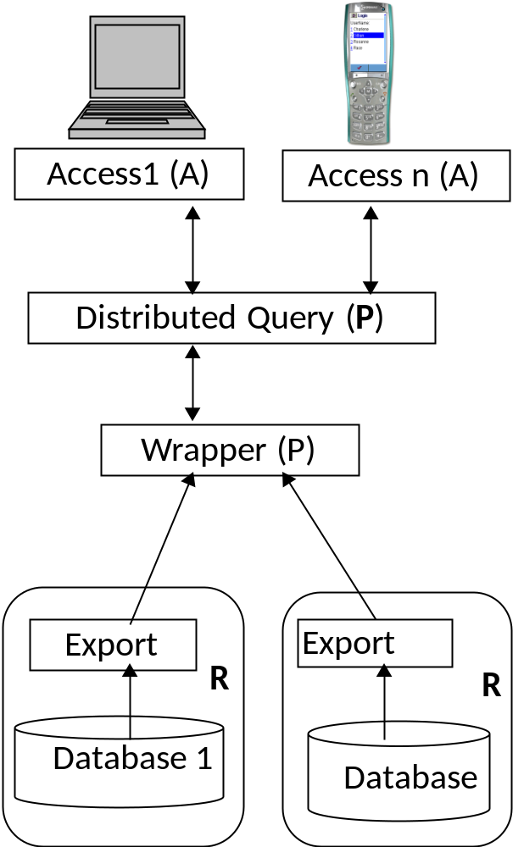
Distributed Data (D) Storage: Distributed Database
Ubiquitous computing: smart devices, environments and interaction

Slide 34
Distributed Processing
Partitioning & distributing processing onto multiple CPUs
Use for computation intensive tasks, e.g., ??
Time gained in ↓ processing time must be > time to partition & distribute tasks, collect individual results & combine them.
Many different architectures
Super-computers - specialised multiple CPU systems
Clusters of networked MTOS computers, e.g., Grids.
Multiple CPUs in MTOS computers. e.g., multi-core processor
P2P computing
Cellular computing
What about
distributed UIs?
Distributed communication?
Ubiquitous computing: smart devices, environments and interaction

Slide 35
Distributed Processing Architectures
Examples can be added here
Ubiquitous computing: smart devices, environments and interaction

Slide 36
Overview
Smart Device and Service Characteristics
Distributed System Viewpoints
System Abstraction
Partitioning and Distribution of System Components
Proxies and Middleware √
Service Oriented Computing (SOC) & Grid Computing
Peer-to-Peer Systems
Service Provision Lifecycle 
Service Discovery
Service Invocation
Service Composition
MTOS, BIOS & VM
Ubiquitous computing: smart devices, environments and interaction

Slide 37
Proxy based Service Access
Advantages of using client proxies
Some applications use a client proxy to simplify access processes in client, How?
Off-load presentation processing and network processing
Hide heterogeneity of terminal types & networks from applications
Simplify and compose access to multiple service providers.
Reduce complexity of communication used in access devices, e.g., ??
Enable devices to operate intermittently in a disconnected state.
Shield network-based applications from mobility of access devices
Ubiquitous computing: smart devices, environments and interaction

Slide 38
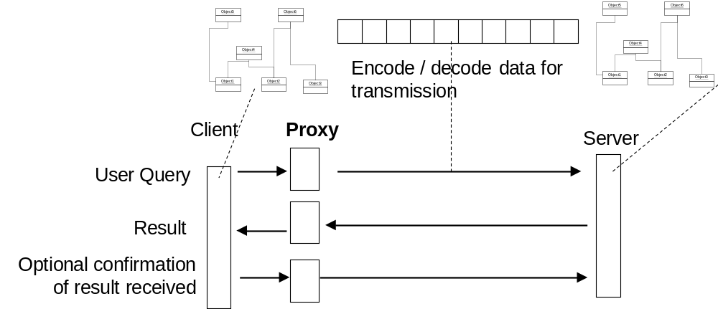
Proxy based Service Access
Use of proxies to simplify network access by transparently encoding and decoding the transmitted data on behalf of clients and / or servers
Ubiquitous computing: smart devices, environments and interaction

Slide 39
Proxy based Service Access
What are the disadvantages of Proxy-based access?
Where does the proxy reside?
Ubiquitous computing: smart devices, environments and interaction

Slide 40
Middleware
↑ Variety & heterogeneity & complexity of services access
Middleware introduced in between applications & OS to simplify access to services
Middleware factors out set of generic services, e.g., database access, file system access etc. to make them:
Advantages for Application?
Advantages for OS?
Ubiquitous computing: smart devices, environments and interaction

Slide 41
Middleware: Design Issues
May be useful for applications to have an awareness of lower level interaction, for resource access not to be completely hidden by middleware.
Why?
Ubiquitous computing: smart devices, environments and interaction

Slide 42
Middleware
Application awareness of ICT Context
Full
Partial
None
  Application sees full ICT system interface, no Middleware used
  Middleware handles some of the complexity in interfacing to ICT system
  Middleware hides complexity of ICT system from application
Ubiquitous computing: smart devices, environments and interaction

Slide 43
Overview
Smart Device and Service Characteristics
Distributed System Viewpoints
System Abstraction
Partitioning and Distribution of System Components
Proxies and Middleware
Service Oriented Computing (SOC) & Grid Computing √
Peer-to-Peer Systems
Service Provision Lifecycle √
Service Discovery
Service Invocation
Service Composition
MTOS, BIOS & VM
Ubiquitous computing: smart devices, environments and interaction

Slide 44
Service Oriented Computing (SOC)
SOA (Architectures) , also referred to as SOC (Computing)
Services as computational or information processing components
  That are autonomous and heterogeneous
  Can run on different platforms
  Are possibly owned by different organizations.
Ubiquitous computing: smart devices, environments and interaction

Slide 45
SOC Standards
Several different standards for SOC
(XML based) Web Services
Computer Grids OGSI
OASIS SOA RM
Open Group SOA Working Group
Semantic Web Services?
Ubiquitous computing: smart devices, environments and interaction

Slide 46
Service Oriented Computing (SOC)
Notion of service characterised by:
Descriptions:
Outcomes:
Offers:
Competency:
Execution:
Composition:
Constraints or policies:
Ubiquitous computing: smart devices, environments and interaction

Slide 47
Service Oriented Computing (SOC)
Service Management
Service Composition
Service Invocation
Service Discovery
Enterprise Service Bus
Ubiquitous computing: smart devices, environments and interaction

Slide 48
SOC: Grids
Grid computing: distributed systems that enable:
(Early) Grid computing system design tends to focus on high performance computing rather than fault-tolerance & dynamic ad hoc interaction,
Ubiquitous computing: smart devices, environments and interaction

Slide 49
SOC: Grids
Three main types of Grid system occur in practice:
Computational Grids:
Data Grids,
Service Grids:
Ubiquitous computing: smart devices, environments and interaction

Slide 50
SOC Grid
GRID System design can be discussed in more detail in a few slides
Ubiquitous computing: smart devices, environments and interaction

Slide 51
Overview
Smart Device and Service Characteristics
Distributed System Viewpoints
System Abstraction
Partitioning and Distribution of System Components
Middleware
Service Oriented Computing (SOC)
Peer-to-Peer Systems √
Service Provision Lifecycle √
Service Discovery
Service Invocation
Service Composition
MTOS, BIOS & VM
Ubiquitous computing: smart devices, environments and interaction

Slide 52
Peer-to-Peer Systems (P2P)
P2P can be defined as:
distributed systems consisting of interconnected nodes
able to self-organize into network topologies
with the purpose of sharing resources such as content, CPU cycles, storage and bandwidth,
capable of adapting to failures and accommodating transient populations of nodes
while maintaining acceptable connectivity and performance
without requiring the intermediation or support of a global centralized servers or authorities.
Ubiquitous computing: smart devices, environments and interaction

Slide 53
P2P Benefits
What are the main benefits?
Ubiquitous computing: smart devices, environments and interaction

Slide 54
P2P System Design Challenges (Limitations)
What are the main challenges or limitations?
Ubiquitous computing: smart devices, environments and interaction

Slide 55
P2P System: Types
3 main types of P2P system depending on the types of computer nodes:
Pure P2P
Partial P2P:
Hybrid P2P networks,
3 basic content access processes in distributed systems to:
  identify nodes,
  register content provision nodes,
  search & retrieve content
Ubiquitous computing: smart devices, environments and interaction

Slide 56
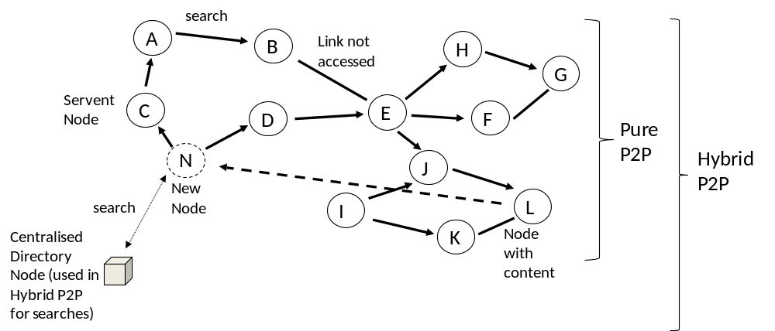
P2P System Types: Pure, Hybrid
Ubiquitous computing: smart devices, environments and interaction
Notes:
-

Slide 57
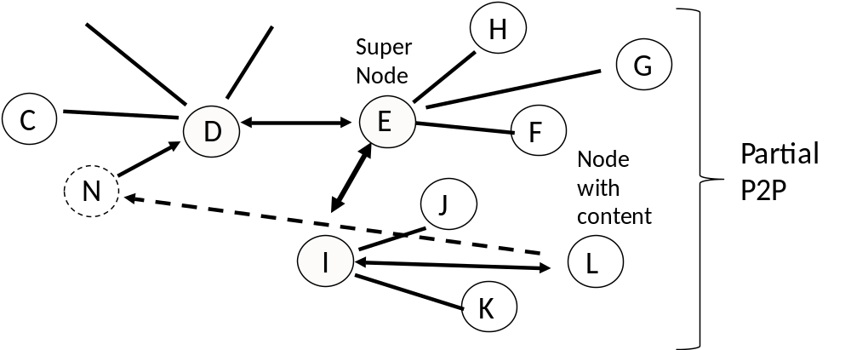
P2P System Types : Partial P2P
Ubiquitous computing: smart devices, environments and interaction
Notes:
-

Slide 58
P2P System Types
Can also be grouped into two main types of topologies for P2P systems that overlay the underlying physical network:
Unstructured overlay networks
Structured overlay networks
Ubiquitous computing: smart devices, environments and interaction

Slide 59
Overview
Smart Device and Service Characteristics
Distributed System Viewpoints
System Abstraction
Partitioning and Distribution of System Components
Proxies & Middleware
Service Oriented Computing (SOC)
Peer-to-Peer Systems
Service Provision Lifecycle √
Service Discovery
Service Invocation
Service Composition
MTOS, BIOS & VM
Ubiquitous computing: smart devices, environments and interaction

Slide 60
Service Provision Life-cycle
Service creation
Service operation
Service maintenance phase
Service dissolution
Ubiquitous computing: smart devices, environments and interaction

Slide 61
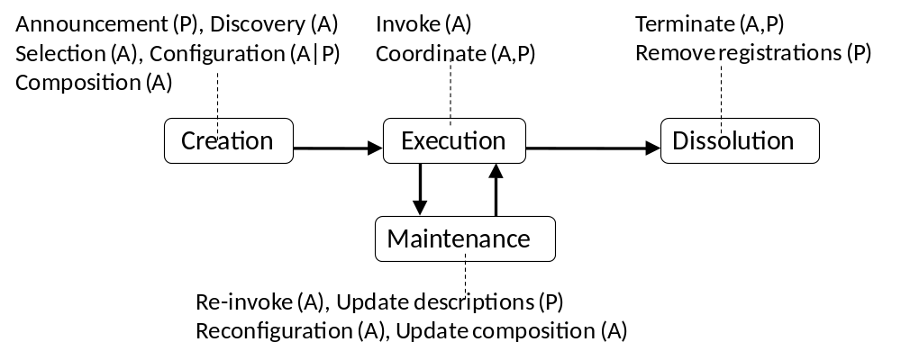
Service Provision Life-cycle
Ubiquitous computing: smart devices, environments and interaction

Slide 62
Service Provision Life-cycle
  Exercise: Consider creation, operation, maintenance, dissolution for the following types of devices & services:
  Laptop / Internet
  Set-top box audio-video receiver
  Mobile phone
  Email Service
Ubiquitous computing: smart devices, environments and interaction

Slide 63
WS SOA Support for Service Life-cycle
Web Services (WS) support machine-to-machine interaction
Service Interfaces are machine-processable, syntactical
WS SOAs consist of many possible WS protocols depending on the application and service requirements.
Core WS SOA protocols are:
  SOAP:
  WSDL:
  UDDI :
Ubiquitous computing: smart devices, environments and interaction

Slide 64
Service Oriented Computing (SOC)
Service Management
Service Composition
Service Invocation
Service Discovery
Enterprise Service Bus
Ubiquitous computing: smart devices, environments and interaction

Slide 65
Service Life-Cycles / SOAs in More Details
Instructors can add further slides here to explain SOAs in more detail or delete this slide.
Ubiquitous computing: smart devices, environments and interaction

Slide 66
Overview
Smart Device and Service Characteristics
Distributed System Viewpoints
System Abstraction
Partitioning and Distribution of System Components
Proxies & Middleware
Service Oriented Computing (SOC)
Peer-to-Peer Systems
Service Provision Lifecycle
Service Discovery √
Service Invocation
Service Composition
MTOS, BIOS & VM
Ubiquitous computing: smart devices, environments and interaction

Slide 67
Service Announcement, Discovery, Selection and Configuration
Service discovery scope & functions depends on design.
What’s involved in service discovery?
Which happens first in service discovery?
    Network discovery
Ubiquitous computing: smart devices, environments and interaction

Slide 68
Network Discovery
What Is it? Why do we need it?
Precedes service registration and service discovery
Dynamic network discovery, used by mobile nodes and when new nodes are introduced into a network.
Which Network Protocols support Network Discovery?
Domain Name Service, DNS, maps IP addresses ↔ Names
Some nodes offer long term services
  static assigned IP addresses may be assigned
  e.g., printers, etc
Common approach to dynamically discover network: DHCP
  Ask a DHCP server for an IP address
  addresses leased for a given time.
  Why is leasing useful?
  Complexity in using DHCP is in setting up & managing DHCP servers. Why?
Ubiquitous computing: smart devices, environments and interaction

Slide 69
Network Discovery: Zeroconf
Zero Configuration Networking (Zeroconf)
Allows inexpert users to connect computers, networked printers etc together & expect them to work automatically.
Without Zeroconf or something similar, need to?
Zeroconf currently solves automating three tasks
Ubiquitous computing: smart devices, environments and interaction

Slide 70
Network Discovery: dynamically assigning IP addresses
Both IPv4 and IPv6 have standard ways of automatically choosing / assigning IP addresses.
IPv4 uses the 169.254.any, link-local set of addresses, see RFC 3927.
IPv6, zeroconf, see RFC 2462 can be used.
2 similar ways of figuring out which network node has a certain name.
  Apple's Multicast DNS (mDNS)
  Microsoft's Link-local Multicast Name Resolution (LLMNR)
Ubiquitous computing: smart devices, environments and interaction

Slide 71
Dynamic Service Discovery
Dynamic versus Static service discovery
Allow requesters to change providers , Why? Vice-versa?
What is involved in Dynamic Service discovery ?
Ubiquitous computing: smart devices, environments and interaction

Slide 72
Dynamic Service Discovery: Pull versus Push
2 main approaches : push or pull.
Pull: How does it work?
Ubiquitous computing: smart devices, environments and interaction

Slide 73
Discovery Services: Push
Push: How does it work?
Ubiquitous computing: smart devices, environments and interaction

Slide 74
Discovery services Push: Design
Broadcast / Announcements can be designed to occur:
Periodically irrespective of whether any audience exists or not;
Only when any kind of audience is available;
Only when a specific type of audience is detected
  multicast versus broadcast.
Ubiquitous computing: smart devices, environments and interaction

Slide 75
Discovery Services: Pull vs. Push
Advantage of Pull?
Disadvantage of Pull?
Ubiquitous computing: smart devices, environments and interaction

Slide 76
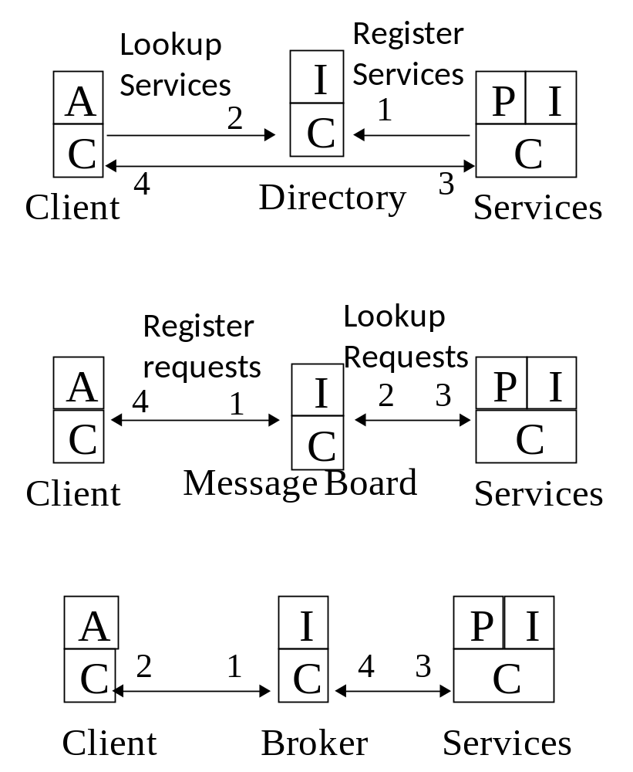
Service Discovery Interaction Patterns
Directory Service
Blackboard
Broker
Ubiquitous computing: smart devices, environments and interaction

Slide 77
External versus Internal service selection
External → services to satisfy request exist in virtual environment to the ICT system, rather than internally within the system itself.
How does a requester of a service know if it needs someone else to perform the service
How does a service requester choose between external service versus internal service invocation when both are available?
Ubiquitous computing: smart devices, environments and interaction

Slide 78
External versus Internal service selection
Process of establishing whether or not a service exists internally can involve
  Self-descriptions
  Self-awareness
  Reflection
See chapter 10
Ubiquitous computing: smart devices, environments and interaction

Slide 79
Semantic Web (SW) and Semantic Resource Discovery
Why is Syntactic level matching and discovery challenging in pervasive environments?
What are benefits of Semantic matching rather than syntactic service matching?
Service Requests Benefits?
Ubiquitous computing: smart devices, environments and interaction

Slide 80
Semantic Web (SW) and Semantic Resource Discovery
SW represents resources using RDFS and OWL
SW defines much richer XML based data structures and relationships
Design choices:
Ubiquitous computing: smart devices, environments and interaction

Slide 81
Semantic Web Service Models
Instructors can decide to explain this in more detail in the following slides or delete this slide.
Ubiquitous computing: smart devices, environments and interaction

Slide 82
Overview
Smart Device and Service Characteristics
Distributed System Viewpoints
System Abstraction
Partitioning and Distribution of System Components
Proxies & Middleware
Service Oriented Computing (SOC)
Peer-to-Peer Systems
Service Provision Lifecycle
Service Discovery
Service Invocation √
Service Composition
MTOS, BIOS & VM
Ubiquitous computing: smart devices, environments and interaction

Slide 83
Distributed Service Invocation
Specifying an application protocol in terms of a set of service descriptions of service actions is often insufficient to invoke a service. Why?
Ubiquitous computing: smart devices, environments and interaction

Slide 84
Distributed Service Invocation
Design of remote interaction across different computer nodes differs from design of local process interaction within the same computer node
Why?
Ubiquitous computing: smart devices, environments and interaction

Slide 85
Distributed Service Invocation: Ordered Service Actions
Service requesters may not know:
  in what order to invoke service actions
  how to handle out of order message sequences in a process without terminating service processes.
Interaction in the process coordinated needs to be coordinated.
Often coordination may be hard-coded into each service API and under the control of the provider.
  Makes the coordination of multiple services inflexible.
Ubiquitous computing: smart devices, environments and interaction

Slide 86
Distributed Service Invocation: Ordered Service Actions
Clients often need to invoke not just individual service actions in isolation but to invoke a whole series of service interactions as part of a business process
Multiple heterogeneous processes often need to be interleaved:.
Network Transmission may or may not maintain order of action messages when these are sent
Complex to design in order to make remote communication (remote procedure calls (RPC) or remote method invocation (RMI) look like local calls , e.g., need parameter marshalling
Ubiquitous computing: smart devices, environments and interaction

Slide 87
Distributed Service Invocation: Fully Ordered Service Actions
Two types of design based upon service action ordering
  Full versus Partial
Fully ordered system processes of actions
Specify actions executed as fixed sequences of actions.
Earlier actions in sequence output data used by later ones
Control of flow may contain some flexibility in terms of branches, conditions and loops.
Example uses?
Suitable for ??
Less suitable for ??
Ubiquitous computing: smart devices, environments and interaction

Slide 88
Distributed Service Invocation: Partially Ordered Actions
Two types of design based upon action ordering
2. Partially or non ordered system processes of actions Non- ordered System
Specify action triggers (events) and action (responses, handling)
Don’t fully order these, may partially order these?
Example Uses
  ??
Suitable for open dynamic environments
See Chapters 8 and 9.
Ubiquitous computing: smart devices, environments and interaction

Slide 89
Distributed Service Invocation: fully versus partially ordering
Advantages and disadvantages of full action ordering?
Advantages and disadvantages of partial action ordering?
Ubiquitous computing: smart devices, environments and interaction

Slide 90
Service Invocation: Separating Coordination & Computation
Should coordination mechanisms be separated from computation mechanisms.?
This supports several key benefits:
Portability
Heterogeneity
Flexibility
Ubiquitous computing: smart devices, environments and interaction

Slide 91
Distributed Service Invocation Coordination Models
Designs for distributed interaction include:
(Remote) Procedure Calls / object-oriented Remote Method interaction:
Layered model:
Pipe-filter model
Event-driven Action or EDA Model:
Shared data repositories:
Ubiquitous computing: smart devices, environments and interaction

Slide 92
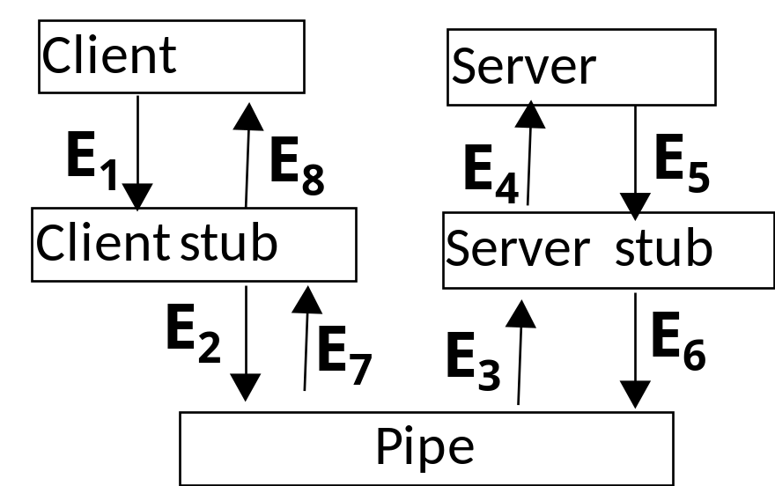
Distributed Service Invocation Data Model: RPC model
Uses?
Ubiquitous computing: smart devices, environments and interaction

Slide 93
Distributed Service Invocation Data Model: RPC model
For each type of service invocation data model we can give more detail about how the interaction model works
(Remote) Procedure Call Model – makes remote calls look like local calls
etc
Ubiquitous computing: smart devices, environments and interaction

Slide 94
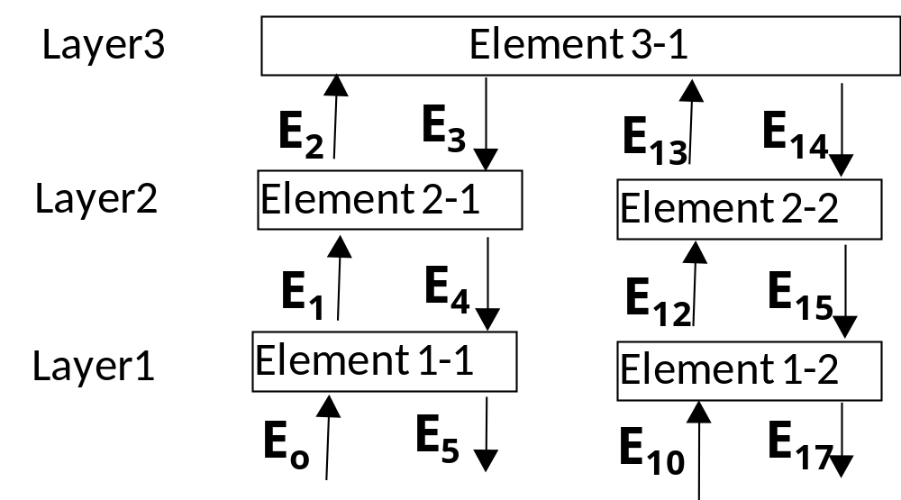
Distributed Service Invocation Data Mode: Layered Model
Layered Model
Uses?
Ubiquitous computing: smart devices, environments and interaction

Slide 95
Distributed Service Invocation Data Model: Pipe-Filter Model
E₁
Pipe
E₁
Filter
E₂
Pipe
E₂
Pipe-Filter Model
Pipe
E₂
Filter
E₃
Uses?
Ubiquitous computing: smart devices, environments and interaction

Slide 96
Distributed Service Invocation Data Model: Shared Data Repository
2 participants communicate by leaving messages for others via some shared intermediary
Examples
  ??
Shared repository system consists of two types of components:
  central data structure represents the current state
  collection of independent components operate on central data store.
2 major sub-types of coordination depending on:
  if transactions in an input stream trigger the selection of executing processes, e.g., a database repository
  if the current state of the central data structure is the main trigger of selecting processes to execute, e.g., a blackboard repository.
Ubiquitous computing: smart devices, environments and interaction

Slide 97
Shared Data Repository: Blackboard
Represents & stores data created & used by other components.
Data is input a repository from data producers.
Data is output from a repository to data consumers.
Ubiquitous computing: smart devices, environments and interaction

Slide 98
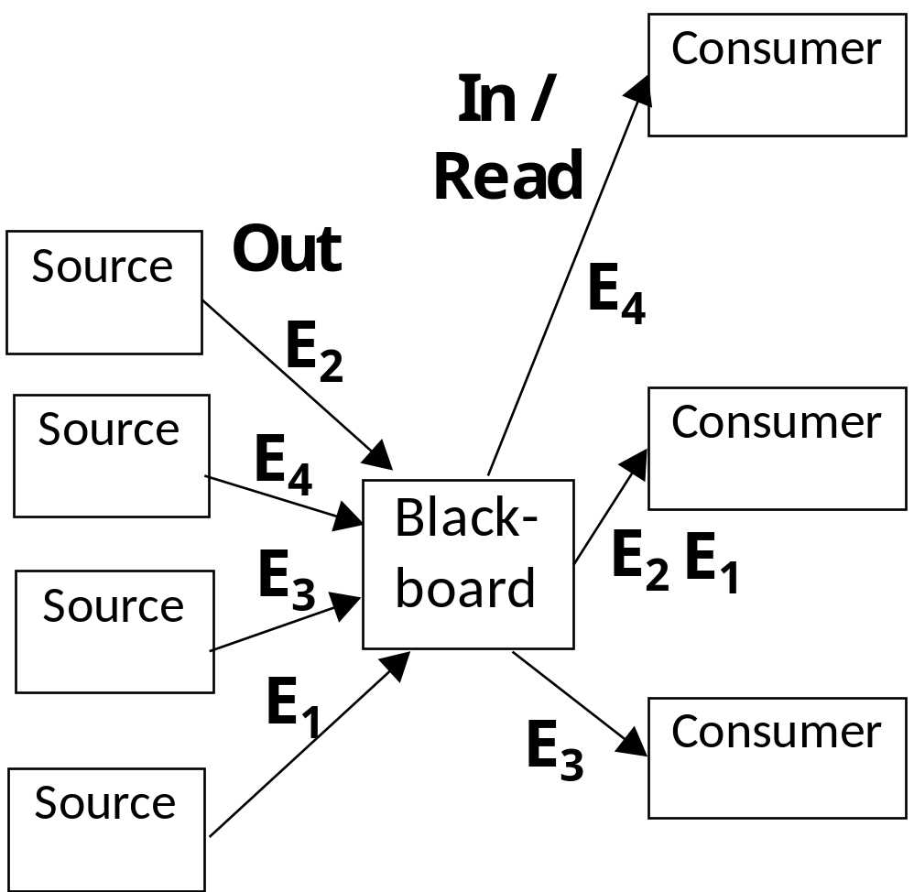
Shared Data Repository: Blackboard
Ubiquitous computing: smart devices, environments and interaction

Slide 99
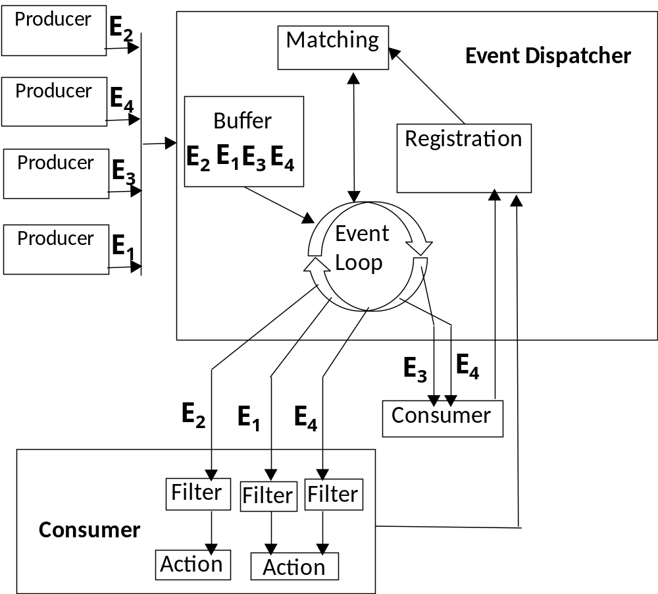
Service Invocation Data Model: EDA
Ubiquitous computing: smart devices, environments and interaction

Slide 100
Distributed Service Invocation Data Model: EDA
Event-Driven Architectures or EDA
EDA model important design for SOC and MOM Architectures
Event is some input such as a message or procedure call of interest
EDA is also known as Publish-and-Subscribe interaction.
Some nodes publish events while others subscribe to being notified when specified events occur
Ubiquitous computing: smart devices, environments and interaction

Slide 101
Distributed Service Invocation Data Model: EDA
A Few events may be significant
  .
Event may cause some predefined threshold to be crossed
  .
Event may be time-based,
  .
External events can trigger services. Services may in turn trigger additional internal events,
  .
Many events may not be significant
Ubiquitous computing: smart devices, environments and interaction

Slide 102
Distributed Service Invocation Data Model: EDA Challenges
Design challenges complexity of EDA?
  Event floods:
  EDA generally have no persistence
  Can be difficult to keep things running through a failure,
Solutions
  Prioritising events
  Event persistence
  Event coordination.
  Highly selective event generation and transmission
Ubiquitous computing: smart devices, environments and interaction

Slide 103
Overview
Service Provision Lifecycle
Service Discovery
Service Invocation √
    Coordination Models
    On-demand Service Invocation √
  Volatile Service Invocation
  ESB versus MOM
Service Composition
Ubiquitous computing: smart devices, environments and interaction

Slide 104
Blackboard versus Event Driven
Compare and contrast?
Ubiquitous computing: smart devices, environments and interaction

Slide 105
On-Demand Distributed Service Invocation
On-demand: remote service access whenever needed
Some data created locally & stored or processed remotely
  E.g., ??
Some data is stored remotely & accessed locally
  E.g., ??
Remote service invocation may involve single read or write data operations
Remote service invocation may involve multiple read or write data operations,
  E.g., ??
Multiple service actions may be integrated into a whole
  E.g., ??
Ubiquitous computing: smart devices, environments and interaction

Slide 106
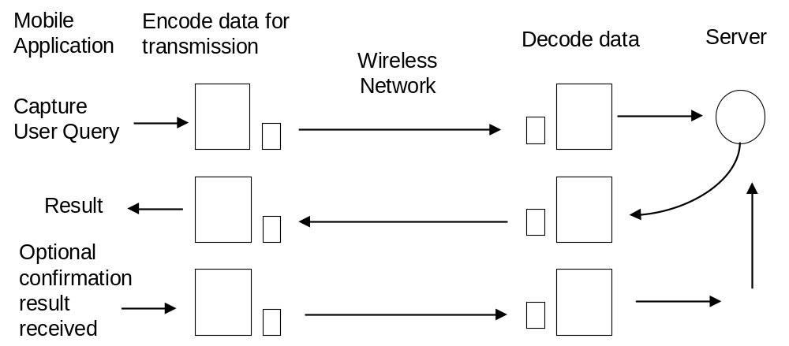
On-Demand Distributed Service Invocation
Service invocation e.g., what is the best flight given these constraints?
Ubiquitous computing: smart devices, environments and interaction

Slide 107
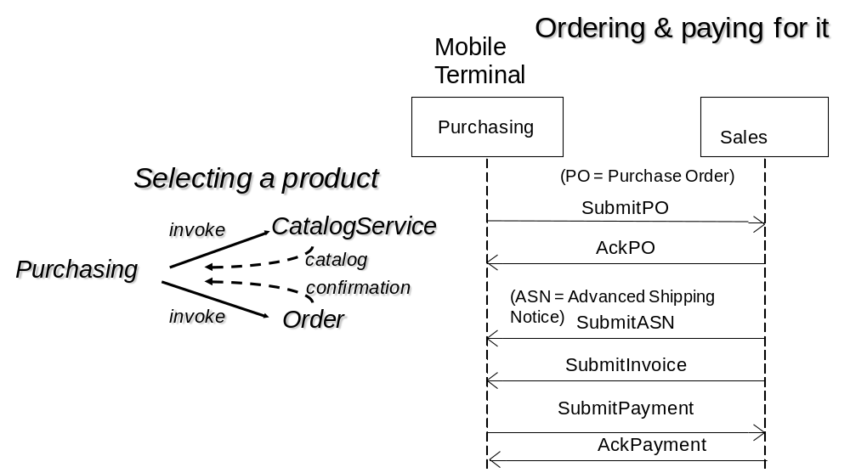
On-Demand Distributed Service Invocation can be Complex
Ubiquitous computing: smart devices, environments and interaction

Slide 108
On-Demand Distributed Service Invocation can be Complex
Ordering & paying for it
Purchasing
Sales
Inventory
Shipping
Bank
SubmitPO
(PO = Purchase Order)
Check/update
AckPO
Confirm / instock
ReqShipping
(ASN = Advanced Shipping Notice)
ShippingArranged
For Next day
SubmitASN
SubmitInvoice
SubmitPayment
TransferFundsRequest
AckPayment
AckTransferFunds
Ubiquitous computing: smart devices, environments and interaction

Slide 109
On-demand Service access
On-demand service interaction suited to thin client interaction. Why?
Suitable for small foot-print / low resource / devices or terminals
Back-end server required continually throughout the transaction
Server-side processing used to
  Process transaction
  Dynamic Server-side device profiling of clients
Ubiquitous computing: smart devices, environments and interaction

Slide 110
On-Demand Services: Request-reply, Pull Design
Request/response is “pull-based” approach
Client, requires instantaneous updates of information
Need highly available network connection
Clients continuously poll service providers
In many mobile applications energy is a scarce resource
Pure pull-based solution may not support the high dynamicity of information resources, that change and move
Pull works if directory service is up to date
Publish/subscribe or EDA can be used so that timely notification of events are sent to interested subscribers.
Ubiquitous computing: smart devices, environments and interaction

Slide 111
Overview
Service Provision Lifecycle
Service Discovery
Service Invocation √
  Coordination Models
  On demand Service invocation
  Volatile Service Invocation √
  ESB versus MOM
Service Composition
Ubiquitous computing: smart devices, environments and interaction

Slide 112
Volatile Service Invocation: Networks
Sometimes service access may be quite intermittent because of intermitted network, Causes?
Ubiquitous computing: smart devices, environments and interaction

Slide 113
Volatile Service Invocation: services
Intermittent service access causes?
  .
Designs of the application and middleware must take volatile into account Why?
  .
Basic designs to handle volatile service access?
Ubiquitous computing: smart devices, environments and interaction

Slide 114
Volatile Service Invocation: Designs
Designs to support volatile service invocation?
Ubiquitous computing: smart devices, environments and interaction

Slide 115
Volatile Service invocation: Over Unreliable Networks
Networks may offer a QoS to deliver messages without loss or delay and in order
Service access over wireless networks often more unreliable than wired networks.
Applications can assume no network guarantee about delivery - need to detect & handle message corruption & message loss. How?
  .
Ubiquitous computing: smart devices, environments and interaction

Slide 116
Volatile Service invocation Design: Stateful Senders & Receivers
Senders and receivers can be stateful
Stateful senders don’t need to create message replacements from scratch
Stateful communication may be more complex to synchronise than stateless communication because the equivalence of intermediate states may need to be compared.
Ubiquitous computing: smart devices, environments and interaction

Slide 117
Volatile Service Invocation: Repeating Service Requests
Before repeating message transmission is to consider the consequences of doing this.
Messages that can be repeated, at least once, without side-effects are called idempotent messages,
  e.g., ??.
Other messages may be non-idempotent,
  e.g., ??.
Ubiquitous computing: smart devices, environments and interaction

Slide 118
Volatile Service Invocation: Repeating Service Requests
Partial observability at sender / requester ↑ complexity. Why?
Ubiquitous computing: smart devices, environments and interaction

Slide 119
Volatile Service Invocation: Asynchronous (MOM) I/O
Problems when senders issues requests to receivers
  ??
Asynchronous messaging can solve this issue. Asynchronous messaging applications such as email over the Internet, SMS over mobile voice networks are often regarded as the first important data applications over these networks respectively.
Two basic variants of asynchronous messaging exist:
  Sender side asynchronous requests
  Receiver side asynchronous requests
Ubiquitous computing: smart devices, environments and interaction

Slide 120
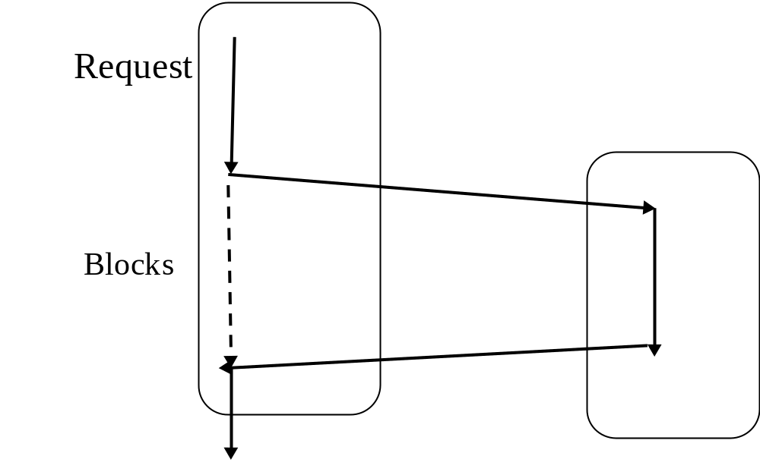
Volatile Service Invocation: Synchronous I/O
Sender Execution Thread or Process
Receiver Execution Thread or Process
Advantages?
Disadvantages?
Ubiquitous computing: smart devices, environments and interaction

Slide 121
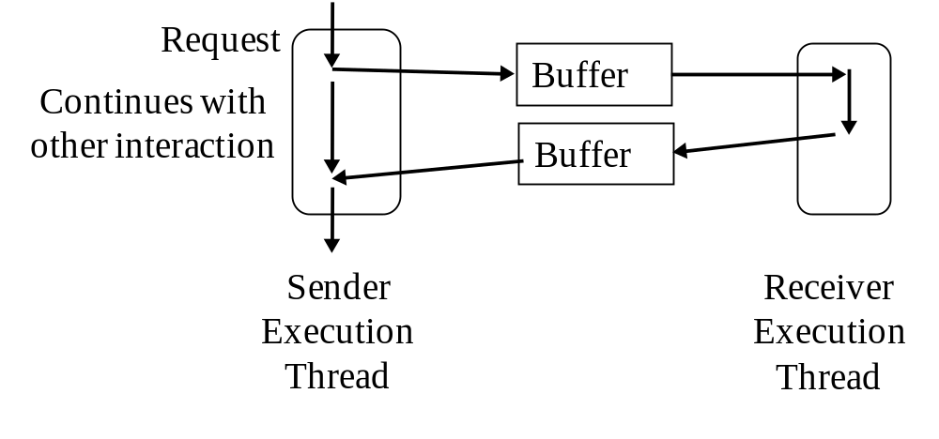
Asynchronous I/O: design based upon buffering
Ubiquitous computing: smart devices, environments and interaction

Slide 122
Volatile Service invocation: read ahead caches
Read ahead is one design option to deal with volatile service invocation
Information is pre-cached in devices when the network is available.
Cache-hit
Cache-miss
Design decisions?
Support frequent caching?
  .
Support less frequent caching?
Ubiquitous computing: smart devices, environments and interaction

Slide 123
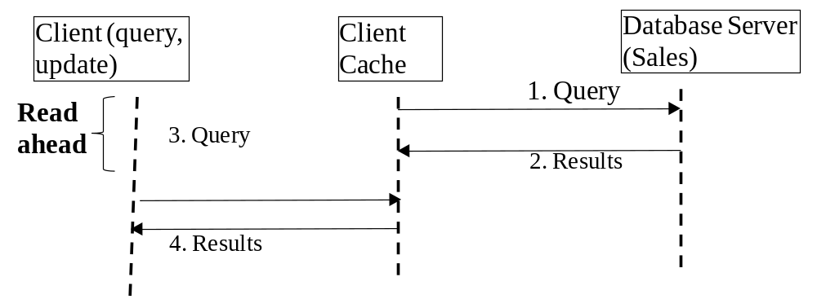
Volatile Service Invocation: Read Ahead
Ubiquitous computing: smart devices, environments and interaction

Slide 124
Volatile Service Invocation: Delayed Writes
With delayed writes, updates are made to the local cache whilst services are unreachable which must be later reintegrated upon reconnection.
Concurrent local and remote updates may need to be synchronised.
Write conflicts need to be detected when the same data has been modified locally and remotely.
Techniques to handle cache misses & cache resynchronisation?
Ubiquitous computing: smart devices, environments and interaction

Slide 125
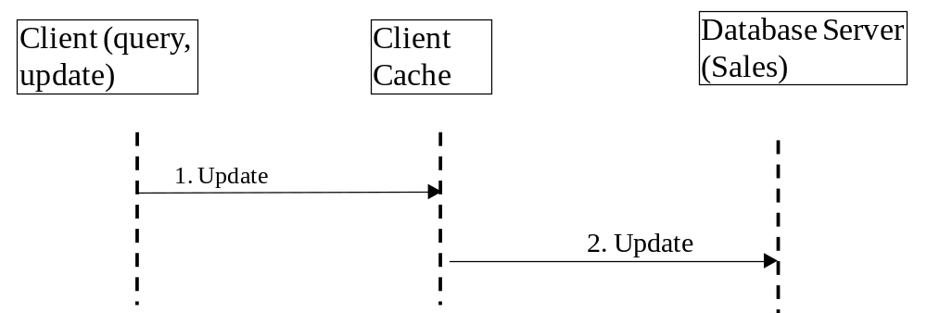
Volatile Service Invocation: Delayed Writes
Ubiquitous computing: smart devices, environments and interaction

Slide 126
Overview
Service Provision Lifecycle
Service Discovery
Service Invocation √
  Data Models
  On demand Service invocation
  Volatile Service Invocation
  ESB versus MOM √
Service Composition
Ubiquitous computing: smart devices, environments and interaction

Slide 127
Service Oriented Computing (SOC)
Service Management
Service Composition
Service Invocation
Service Discovery
Enterprise Service Bus
Ubiquitous computing: smart devices, environments and interaction

Slide 128
Service Invocation: ESB Model
Enterprise Service Bus or ESB supports messaging, Web Service integration, data transformation and intelligent routing for SOC
  Decouples service provision from service access.
2 main types of design
  MOM ESB
  SOC ESB
Ubiquitous computing: smart devices, environments and interaction

Slide 129
Service Invocation: MOM ESB Model
MOM (Message-Oriented Middleware) are examples of asynchronous messaging systems:
  Other examples., ??
Often use mediators have facilities to store, route and transform messages.
Lack of agreed standards for MOM
Ubiquitous computing: smart devices, environments and interaction

Slide 130
Service Invocation: MOM ESB Model
Where to support asynchronous messaging?
  .
MOM solutions tend to be more robust to failures than RPC
Enables service requesters to continue to process other requests and not block.
But MOM-based applications are complex to design. Why?
Ubiquitous computing: smart devices, environments and interaction

Slide 131
Service Invocation: MOM ESB Model
MOM designS for ESB support
  ???
MOMs may mandate a specific application level / transport protocol
  .
MOM ESB may itself not be modelled as a direct Web service or first-class service
  .
Ubiquitous computing: smart devices, environments and interaction

Slide 132
Service Invocation: SOA ESB Model
SOC model for ESB as opposed to a message-oriented model offers fuller support for three types of integration:
integrating multiple service access, e.g., behaving as a portal;
integrating multiple application service processes,
supporting work-flows, brokerage and propagation; supporting data translation.
Ubiquitous computing: smart devices, environments and interaction

Slide 133
Overview
Smart Device and Service Characteristics
Distributed System Viewpoints
System Abstraction
Partitioning and Distribution of System Components
Proxies & Middleware
Service Oriented Computing (SOC)
Peer-to-Peer Systems
Service Provision Lifecycle
Service Discovery
Service Invocation
Service Composition √
MTOS, BIOS & VM
Ubiquitous computing: smart devices, environments and interaction

Slide 134
Service Composition: Service Interoperability
The ability to communicate at the network level is insufficient to interoperate at service level. Why?
Difference between integrated services versus interoperable (or federate) services?
Ubiquitous computing: smart devices, environments and interaction

Slide 135
Service Composition: Service Interoperability
Distributed systems that interoperate can exchange data in a variety of data formats, encodings, etc.
2 methods for heterogeneous data exchange:
common or canonical exchange data format is used
receiver or sender makes it right scheme
  .
Which is best?
Ubiquitous computing: smart devices, environments and interaction

Slide 136
Service Composition
Service processes are sequences of individual service actions that are scheduled for execution.
Service processes may involve one or more entities, one or more actions and involve one or more processes.
Composition concerns?
  .
Statically organising services design issues.
Dynamic service composition?
Ubiquitous computing: smart devices, environments and interaction

Slide 137
Service Composition
Composition can occur incrementally
Why / Benefits?
  .
Composition Management
See later, chapter 9
Ubiquitous computing: smart devices, environments and interaction

Slide 138
Service Composition: Orchestration
Term orchestration in music
  .
Orchestrator tends to hold a global viewpoint of:
  Service actions
  Service constraints for participants
Service composition can be specified
  manually or
  automatically.
Ubiquitous computing: smart devices, environments and interaction

Slide 139
Service Composition: Choreography
Derived from the Greek words for “dance” and “write”
Participants are usually more responsive to:
  local viewpoints of the service actions of self
  the adjacent service action of others
  less use of global view.
More about Choreography designs in chapter 9
Ubiquitous computing: smart devices, environments and interaction

Slide 140
Service Orchestration versus Service Choreography?
Service orchestration is simpler to design & manage
Service orchestration is more commonly used in SOAs
etc
Ubiquitous computing: smart devices, environments and interaction

Slide 141
Service Composition: dynamic
Several approaches exist to automate service composition:
  business processes,
  Work-flow,
  Semantic Web
  MAS planning.
See Chapter 9
Ubiquitous computing: smart devices, environments and interaction

Slide 142
Overview
Smart Device and Service Characteristics
Distributed System Viewpoints
System Abstraction
Partitioning and Distribution of System Components
Proxies & Middleware
Service Oriented Computing (SOC)
Peer-to-Peer Systems
Service Provision Lifecycle
Service Discovery
Service Invocation
Service Composition
MTOS, BIOS & VM √
Ubiquitous computing: smart devices, environments and interaction

Slide 143
Operating System (OS)
OS: system software that:
  Controls/abstracts hardware
  Manages resources and processes to support different applications
OS enables user applications to be ↑ simpler & device-independent
  Applications use API to access hardware and OS
3 main resources of system are Managed. What?
In mobile, resource constrained devices additional resources are managed. What?
  Power (See Section 4.3)
  UI & Content (See Section 7.6.1.2)
Ubiquitous computing: smart devices, environments and interaction

Slide 144
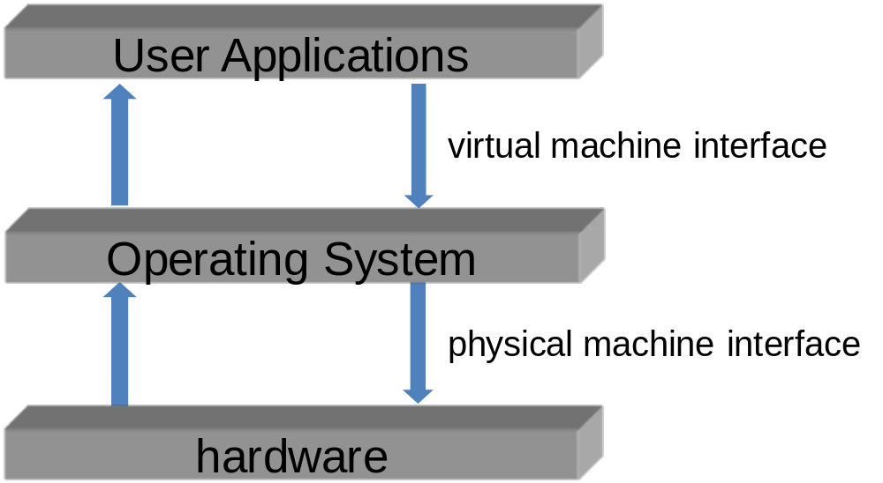
Operating System
Typically a 3-tier architecture
Ubiquitous computing: smart devices, environments and interaction

Slide 145
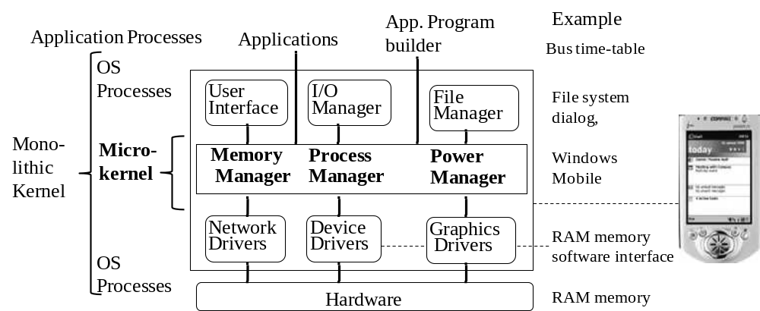
Operating System
Ubiquitous computing: smart devices, environments and interaction

Slide 146
OS: Macro kernel
Macro-Kernel (Monolithic Kernel)
Everything in One Single Large Kernel
  i.e., Hardware related, i.e., device drivers, MM, process support, Scheduling, Network protocol stack, File system
  e.g., versions of Linux
Benefits?:
Drawbacks?:
Ubiquitous computing: smart devices, environments and interaction

Slide 147
OS: Micro-Kernel
Only fundamental parts in kernel. Which?
Benefits?
Drawbacks?
Ubiquitous computing: smart devices, environments and interaction

Slide 148
OS: Process Management
OS Kernel is a special process that ….
Has full access rights to all physical resources
Has its own protected address space for its data memory
It runs the CPU in a special mode called the supervisor mode.
Creates an execution environment for processes to safely run in memory (outside the kernel space).
Ubiquitous computing: smart devices, environments and interaction

Slide 149
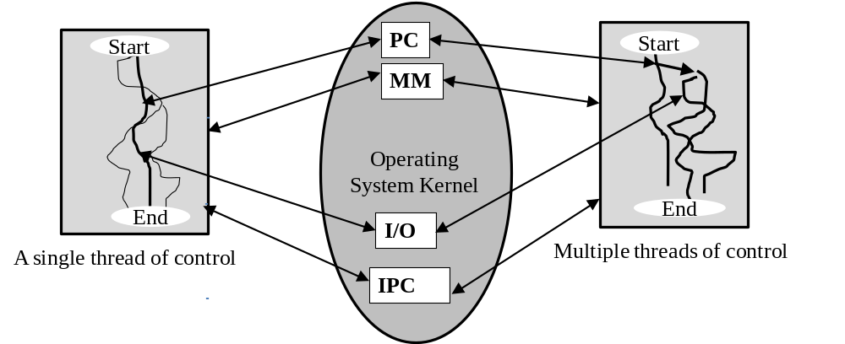
MTOS: Process Management
Ubiquitous computing: smart devices, environments and interaction

Slide 150
MTOS: Process vs. Thread Management
???
Ubiquitous computing: smart devices, environments and interaction

Slide 151
Operating System: Process Management
OS kernel coordinates multiple processes use of CPU
OS manages inter-process communication.
Sometimes No. of executable processes > No. CPUs
Executing processes can block waiting for resources. Why?
  Solution?
Ubiquitous computing: smart devices, environments and interaction

Slide 152
Operating System: Process Scheduling
Pre-emptive scheduler (Simplest):
Non pre-emptive scheduler:
Priority scheduling:
Ubiquitous computing: smart devices, environments and interaction

Slide 153
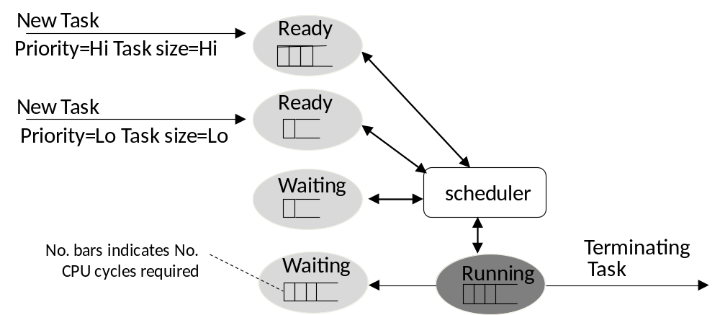
OS: Process Management or Control
Ubiquitous computing: smart devices, environments and interaction

Slide 154
Memory Management
Processes associated with Virtual Memory / address space
OS kernel defines a separate region of address space for each process
Each process has separate (primary) memory area
What if more processes than memory?
Ubiquitous computing: smart devices, environments and interaction

Slide 155
Distributed System OS
Much ICT use is inherently distributed
Devices are distributed
Distributed Service invocation (review Section 3.3.3)
Ubiquitous computing: smart devices, environments and interaction

Slide 156
BIOS
Often when a computer is started or booted, also called bootstrapped, software is loaded in stages.
BIOS or Basic Input/Output System, a type of firmware, is loaded.
BIOS initialises several motherboard components and peripherals, e.g., ?
BIOS loads & transfers control to OS
Ubiquitous computing: smart devices, environments and interaction

Slide 157
Service Virtualisation
In practice, complete service abstraction is hard to achieve. Why?
Physical resources such as hardware resources can be virtualised
Combination of the virtualisation and abstraction
Ubiquitous computing: smart devices, environments and interaction

Slide 158
Virtual Machines (VM)
Important uses of virtualisation. What?
Virtual Machines support. What?
Ubiquitous computing: smart devices, environments and interaction

Slide 159
VM: Process vs. System
2 different types of VM
(application) process viewpoint : Process VM
(operating) system viewpoints: System VM
Ubiquitous computing: smart devices, environments and interaction

Slide 160
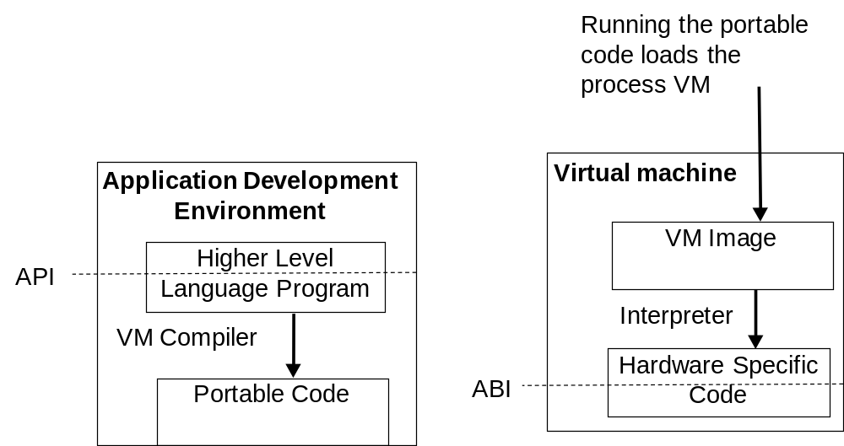
Process Virtual Machines
Ubiquitous computing: smart devices, environments and interaction

Slide 161
Virtual Machine: System VM
System VM - the original type of VM developed in the 1960s and 1970s for mainframes
System VM enable multiple OS systems and application to be run on the same hardware
If one system VM fails, others are isolated and keep running.
Still a useful technique in modern servers and server farms that need to support multiple users and their applications and share hardware resources amongst them.
Ubiquitous computing: smart devices, environments and interaction

Slide 162
Overview
Smart Device and Service Characteristics √
Distributed System Viewpoints √
System Abstraction √
Partitioning and Distribution of System Components
Middleware √
Service Oriented Computing (SOC)
Peer-to-Peer Systems √
Service Provision Lifecycle √
Service Discovery √
Service Invocation √
Service Composition √
MTOS, BIOS & VM √
Ubiquitous computing: smart devices, environments and interaction

Slide 163
Summary & Revision
For each chapter
See book web-site for chapter summaries, references, resources etc.
Identify new terms & concepts
Apply new terms and concepts: define, use in old and new situations & problems
Debate problems, challenges and solutions
See Chapter exercises on web-site
Ubiquitous computing: smart devices, environments and interaction

Slide 164
Exercises: Define New Concepts
Service discovery etc
Ubiquitous computing: smart devices, environments and interaction

Slide 165
Exercise: Applying New Concepts
What is the difference between service push and service pull?
Ubiquitous computing: smart devices, environments and interaction

